Slide 1
LinkedIn Edunet
STUDENT PERFORMANCE ANALYSIS AND GRADE DISTRIBUTION
P R E S E N T A T I O N 2 0 2 6
👤
Student Name
✉
Student Email
amreenshaikh731@gmail.com
AMREEN SHAIKH
📖
UMAMAHESWARI

Slide 2
edunet
foundation
OUTLINE
• Abstract of the Project
• Problem Statement
• Proposed Solution
• System Architecture
• Live Demo of the Project
• Embedded Video of Project
• Conclusion
• Future Scope

Slide 3

edunet
foundation
Abstract
This project analyzes student performance data using Excel and Power BI.
It focuses on cleaning, analyzing, and visualizing academic data.
The goal is to identify trends, grade distribution, and insights.
AI tools like Copilot are used for better insights.

Slide 4
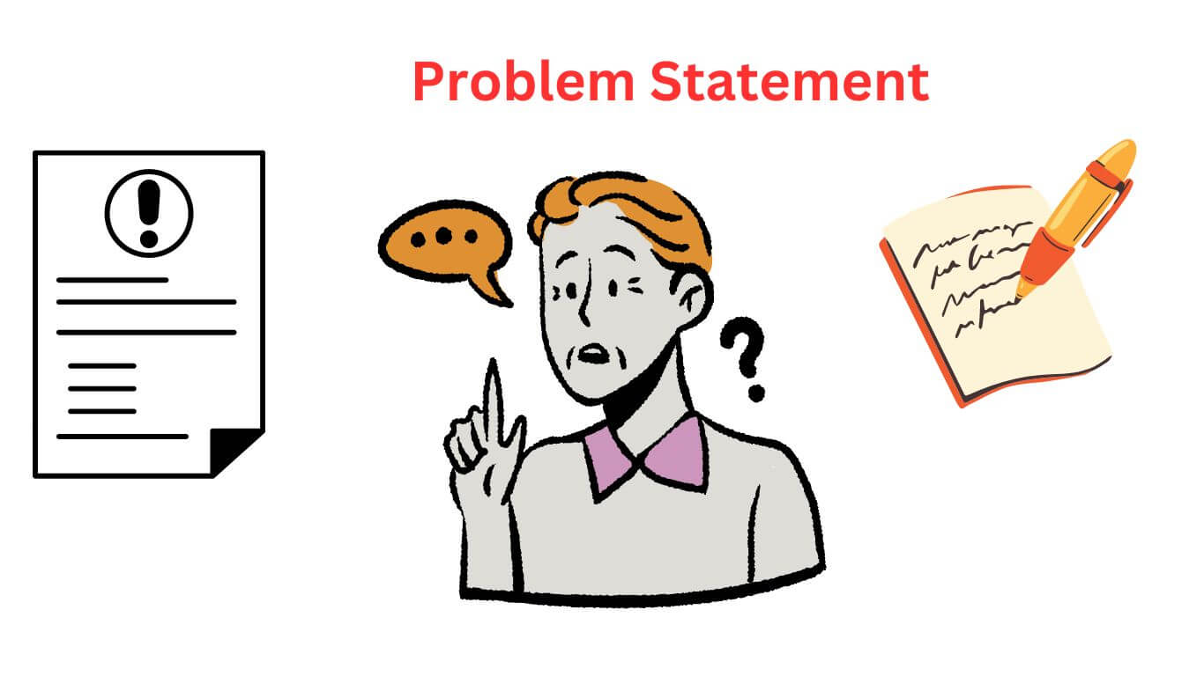
edunet
foundation
Problem Statement
Educational data is often unstructured and hard to analyze.
Institutions struggle to track student performance.
Lack of visualization tools makes insights difficult.
This project solves it using data analytics and dashboards.

Slide 5

edunet
foundation
Proposed Solution
Clean and preprocess student data.
Use Excel & Power BI for analysis.
Create dashboards and visual reports.
Integrate AI tools for automated insights.

Slide 6
edunet
foundation
System Architecture
Data Input / Source
Processing / Analysis
Excel / Kaggle Dataset
Data cleaning and analysis date
AI / Tool Integration
Output / Dashboard
Dashboard / Reports
Copilot / Chatgpt

Slide 7
edunet
foundation
Live Demo of Project
Here's the list of some demo screenshots / features of the project:
🖼
🖼
🖼
Demo 1
Demo 2
Demo 3
Demo 1 : Dashboard Overview
Demo 2 : Grade Distribution Chart
Demo 3 : Subject Wise Analysis

Slide 8
edunet
foundation
Video of Project Demo
[https://your-project-demo-link.com]
▶
[Insert your project demo video.
You can embed a video your live project.]

Slide 9
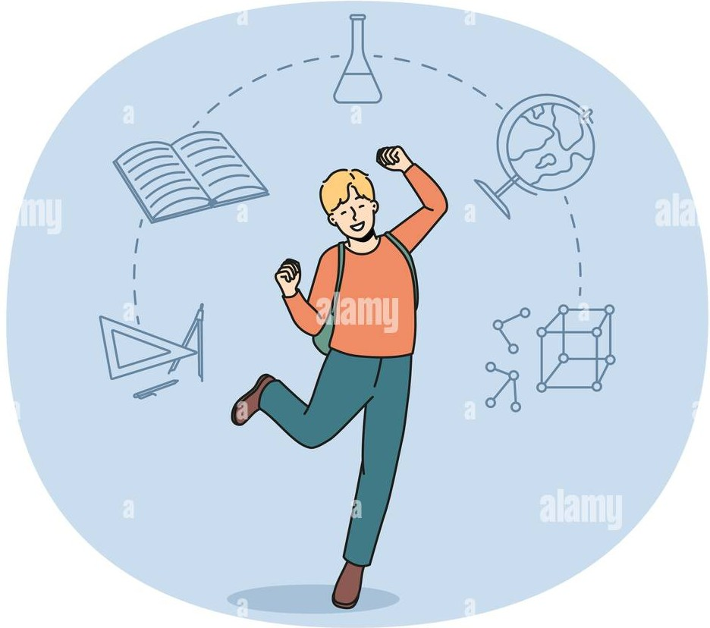
edunet
foundation
Conclusion
✅
• Abstract of the Project
Project successfully analyzes student data.
Helps identify trends and weak areas.
Supports better academic decisions.
Objectives achieved successfully.
• Problem Statement
• Proposed Solution
• System Architecture
• Live Demo of the Project
• Embedded Video of Project
• Conclusion
CONCLUSION
• Future Scope

Slide 10


AI predicts student performance and identifies weak students
🎯 Personalized learning for better understanding
📊 Real-time dashboards and data visualization
‍🏫 Smart systems with automated grading
📱 Use of mobile apps and EdTech tools
edunet
foundation
Future Scope

Slide 11
edunet
foundation
Thank You
AICW Fellowship | Student Project Presentation 2026
LinkedIn | Edunet Foundation

